Slide 1
Inheritance in Java
It means to take something that is already made for reusability purpose, through which we derived classes from other classes. The derived class is called as child class or the subclass, and we can say the extended class and the class from which we are deriving the subclass is called the base class or the parent class.
Hierarchical Inheritance
In hierarchical type of inheritance, one class is extended by many subclasses.
It is one-to-many relationship.
Example in Assignment 6
parent class
Class BoardGame
(given)
child class
Class TurnBasedGame
(given)
child’s child classes
Class TicTacToe
(given)
Class Connect4
(given)
Class Reversi
(to be completed)

Slide 2
Features of Inheritance
Child class can inherit all methods and properties of the parent class except for the private ones;
Child class can define its own methods and properties, thus extending the parent class;
Child class can override the method from the parent class to make it have new function.
Example
parent class
public class BoardGame extends JFrame implements ActionListener{
public BoardGame(){…}
…
protected void addLineToOutput(String str){…}
protected void gameAction(JButton triggeredButton) { … }
The object of child class can also call this function defined in the parent class.
child class
public class TurnBasedGame extends BoardGame {
public TurnBasedGame(){…}
…
protected boolean checkEndGame(){…}
@Override
protected void gameAction(JButton triggeredButton) { … }
New method of the child class.
Modifier “@Override” above the method means the re-implementation of the method inherited from the parent class; note the method name is fixed.

Slide 3
Assignment 6:
Class BoardGame
(given)
Class TurnBasedGame
(given)
Class TicTacToe
(given)
Class Connect4
(given)
Class Reversi
(to be completed)
BoardGame: initialize the game board with the method initializeBoardGame; receive the operation signal and perform actions with actionPerformed and addLineToOutput; two methods initGame and gameAction that can be inherited by the child classes.
TurnBasedGame: construct two players and define the turn rules for them; override the initGame and gameAction methods to make them more detailed.
TicTacToe and Connect4: define the detailed operations based on TurnBasedGame, and check the ending and winner of the game based on current operations.

Slide 4
Assignment 6:
Class BoardGame
(given)
Class TurnBasedGame
(given)
Class TicTacToe
(given)
Class Connect4
(given)
Class Reversi
(to be completed)
Tips:
1. You just have to complete the class Reversi that is a subclass of TurnBasedGame;
2. Read the given source code files, in which TicTacToe is a good reference for you to begin with;
3. Run all given classes one-by-one to understand their behaviours and the coordinates systems, as they have independent "main" classes.

Slide 5
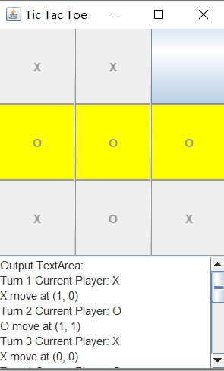
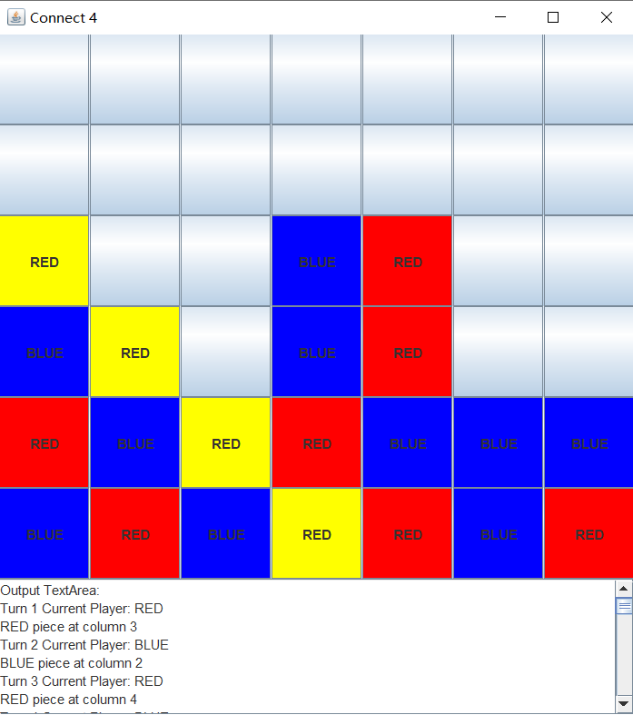
TicTacToe
Connect4
Winner is “o”, with three pieces in a line
Winner is “o”, with four pieces in a line

Slide 6
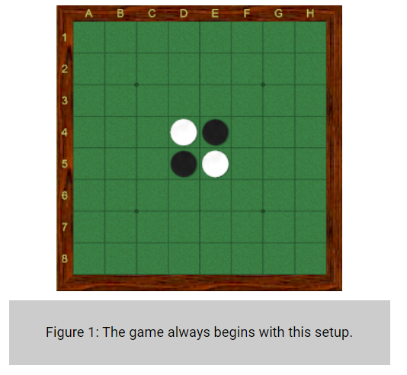

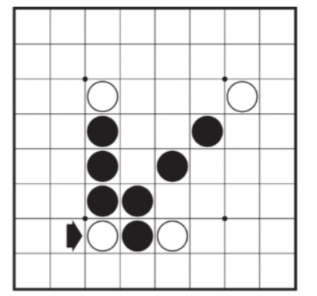
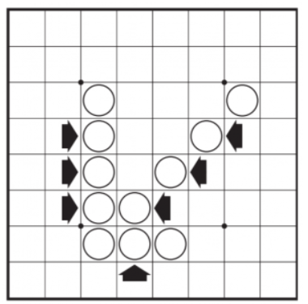
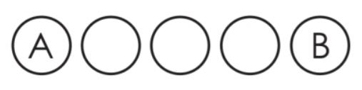
Introduction of Reversi
1. 8x8 board, white & black has 32 pieces, with 4 pieces initialized as below; Black always moves first.
2. White disc A was already in place on the board. The placement of white disc B outflanks the row of three black discs.
3. If on your turn you cannot outflank and flip at least one opposing disk, your turn is passed to your opponent. However, if a valid move is available to you, you may not forfeit your turn.
See more detailed rules for Reversi:
https://www.worldothello.org/about/about-othello/othello-rules/official-rules/English;
https://en.wikipedia.org/wiki/Reversi#Rules.

Slide 7
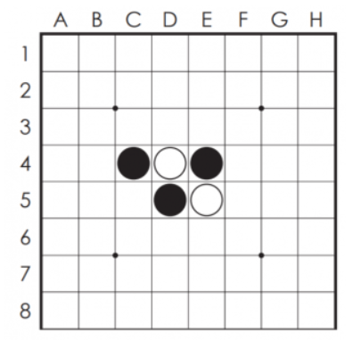
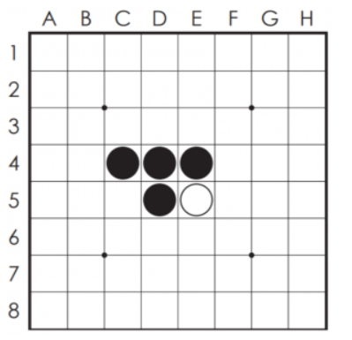
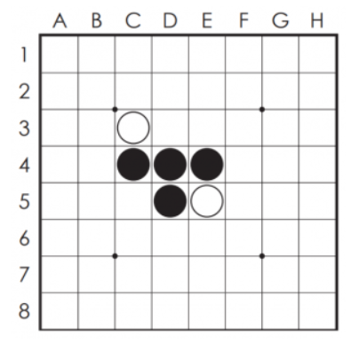
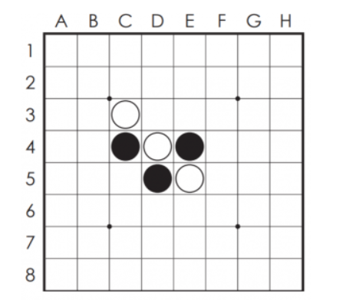
Introduction of Reversi
①
②
A valid move is one where at least one piece is reversed (flipped over), e.g., step 1&2.
Capture the middle while piece
White → Black
③
④
The reversing is checked in 8 possible directions.

Slide 8
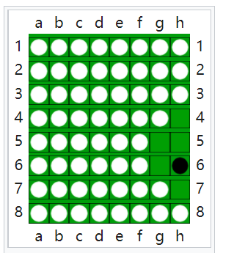
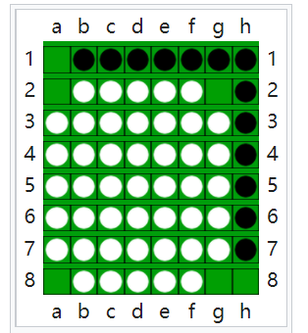
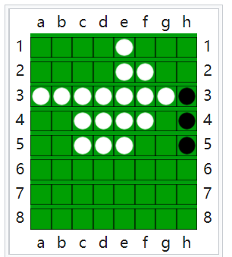
Introduction of Reversi
How to ends ?
When neither player can move (named double-pass), the game ends. This occurs when the grid has filled up or when neither player can legally place a piece in any of the remaining squares, with examples as below:
White win
White win
White win
Winner : The player with the most pieces on the board at the end of the game wins.

Slide 9
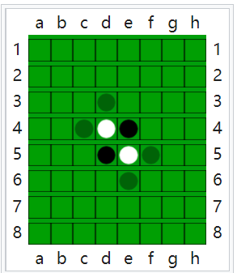
How to detect neighbouring consecutive opponent pieces?
A straightforward way:
Black turn:
Traverse all black pieces and filter those ones that have white pieces as neighbors in any of the 8 directions;
For each filtered black piece, traverse along the 8 directions. In each direction, if there exists one or consecutive white pieces, and there exists an unfilled position at the end of the white piece sequence. Mark the position as a valid move.
Collect all valid moves and analyze the gain for each one, then decide one of them as your next move.
Tips:
There may exist more efficient way to collect the valid moves;
The key lies in the analysis of the gain for each valid move, which decides whether you can win your opponent.

